Slide 1
BIBLE DingBats

Slide 2
INSTRUCTIONS
You will be shown a puzzle, essentially based on word play. Usually, the position or size of the letters is important. Pay close attention to the formation of each of these word-based clues and use your vocabulary and pattern recognition skills to crack the phrase.

Slide 3
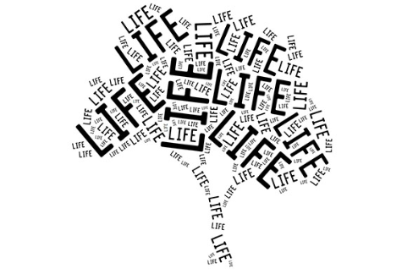
Tree of Life

Slide 4

Burning Bush

Slide 5
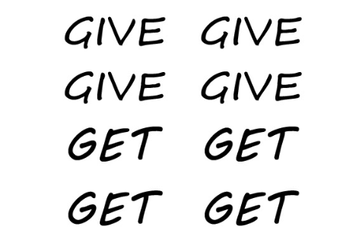
Forgive and forget

Slide 6
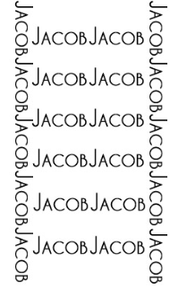
Jacobs Ladder

Slide 7
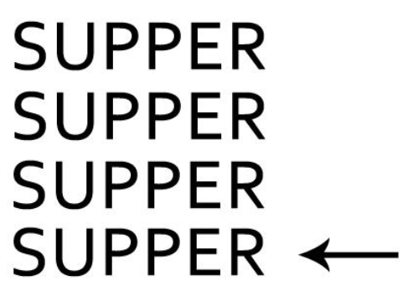
Last supper

Slide 8
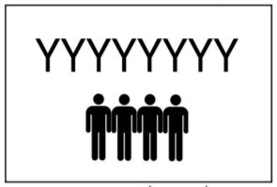


Wise Men

Slide 9

Nothing New under the sun

Slide 10

Golden Calf

Slide 11

Faith in god

Slide 12
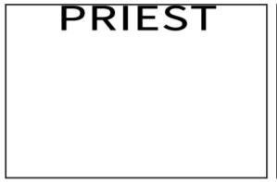
High priest

Slide 13
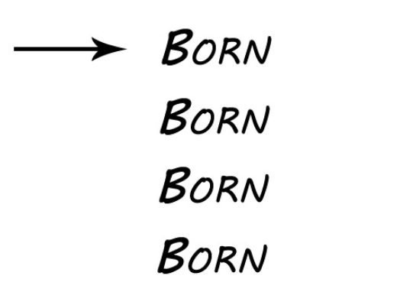
First born

Slide 14

Crossing the red sea

Slide 15
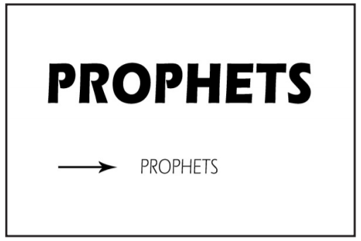
Minor prophets

Slide 16

Holy spirit

Slide 17
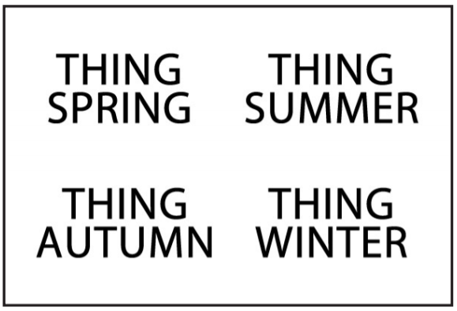
Everything has a season

Slide 18
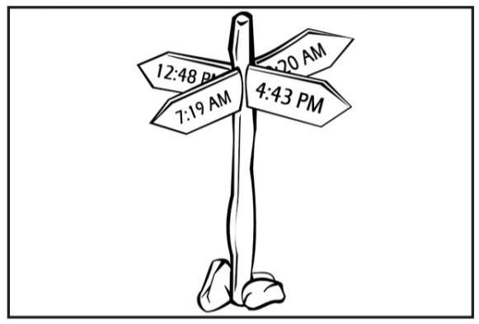
Sign of the times

