Slide 1
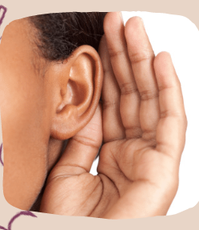
Guess that sound ice breaker

Slide 2
Instructions – A sound will be played. Once you hear the sound, name a bible story that the sound is associated with.

Slide 3
Instructions – There may be instances where one sound can be associated with more than one bible story

Slide 4
Instructions – Once the story you name is associated with the sound you will earn a point. Only the first correct answer within the chat is scored.

Slide 5

Example – Guess that Sound

Slide 6
Example – Guess that Sound
Roaring Lion
Story Examples:
Daniel in the Lions Den
Samson Kills a Lion

Slide 7
Guess that Sound

Slide 8
Guess that Sound
Storm
Possible Stories:
Jesus Calms the Sea
Jonah

Slide 9
Guess that Sound

Slide 10
Guess that Sound
Building Falling/Collapsing
Possible Stories:
Walls of Jericho

Slide 11
Guess that Sound

Slide 12
Guess that Sound
Sheep
Possible Stories:
The parable of the Lost Sheep

Slide 13
Guess that Sound

Slide 14
Guess that Sound
Eating an Apple
Possible Stories:
Eve eats the fruit

Slide 15
Guess that Sound

Slide 16
Guess that Sound
Coins
Possible Stories:
Parable of the Lost Coin

Slide 17
Guess that Sound

Slide 18
Guess that Sound
Donkey
Possible Stories:
The Talking Donkey
Jesus Rides a Donkey

Slide 19
Guess that Sound

Slide 20
Guess that Sound
Fire
Possible Stories:
Moses at the burning bush
The three Hebrew boys

Slide 21
Guess that Sound

Slide 22
Guess that Sound
Pig
Possible Stories:
Prodigal Son
Legion

Slide 23
Guess that Sound

Slide 24
Guess that Sound
Harp
Possible Stories:
David plays music
for King Saul

Slide 25
Guess that Sound

Slide 26
Guess that Sound
Frog
Possible Stories:
10 plagues of Egypt

Slide 27
The End

